Slide 1
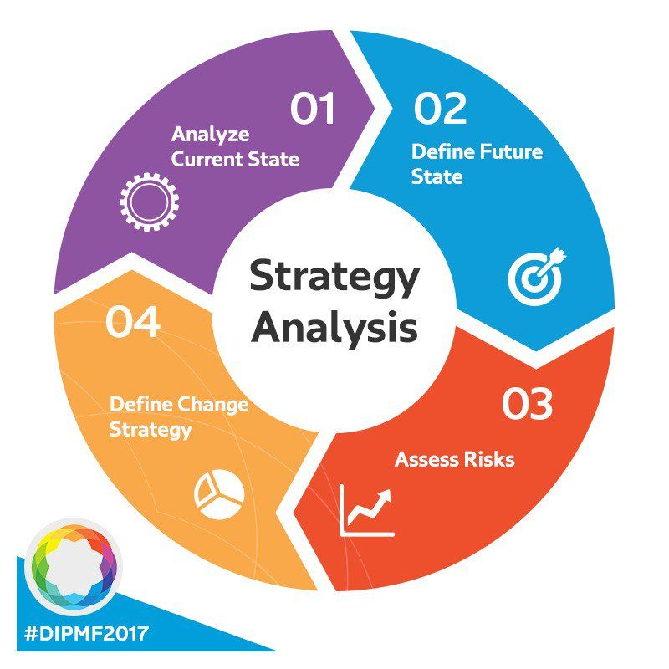
STRATEGIC ANALYSIS

Slide 2
Strategy analysis:
Strategic analysis provides an overview of the key factors which can affect the current and future performance of company.
It helps in understanding the company´s strategic position. It is important to analyze environmental changes and find out how they can affect the company and its employees.
Strategic analysis aims to create a view of the key factors which can have an impact on the present and future performance of the company.
If strategic analysis is carried out in a correct manner then it will help in choosing the right strategy.

Slide 3
Definitions of strategic analysis often differ, but the following attributes are commonly associated with it
1.Identification and evaluation of data relevant to strategy formulation.
2. Definition of the external and internal environment to be analyzed.
3. A range of analytical methods that can be employed in the analysis

Slide 4

Business Environment:
The term “Business environment " is the sum of all conditions, events, and influences that surround and affect business activities and growth.
The forces which constitute the business environment are its suppliers, competitors, consumer groups, media, government, customers, economic conditions, market conditions, investors, technologies, trends, and multiple other institutions working externally of a business constitute its business environment. These forces influence the business even though they are outside the business boundaries.

Slide 5
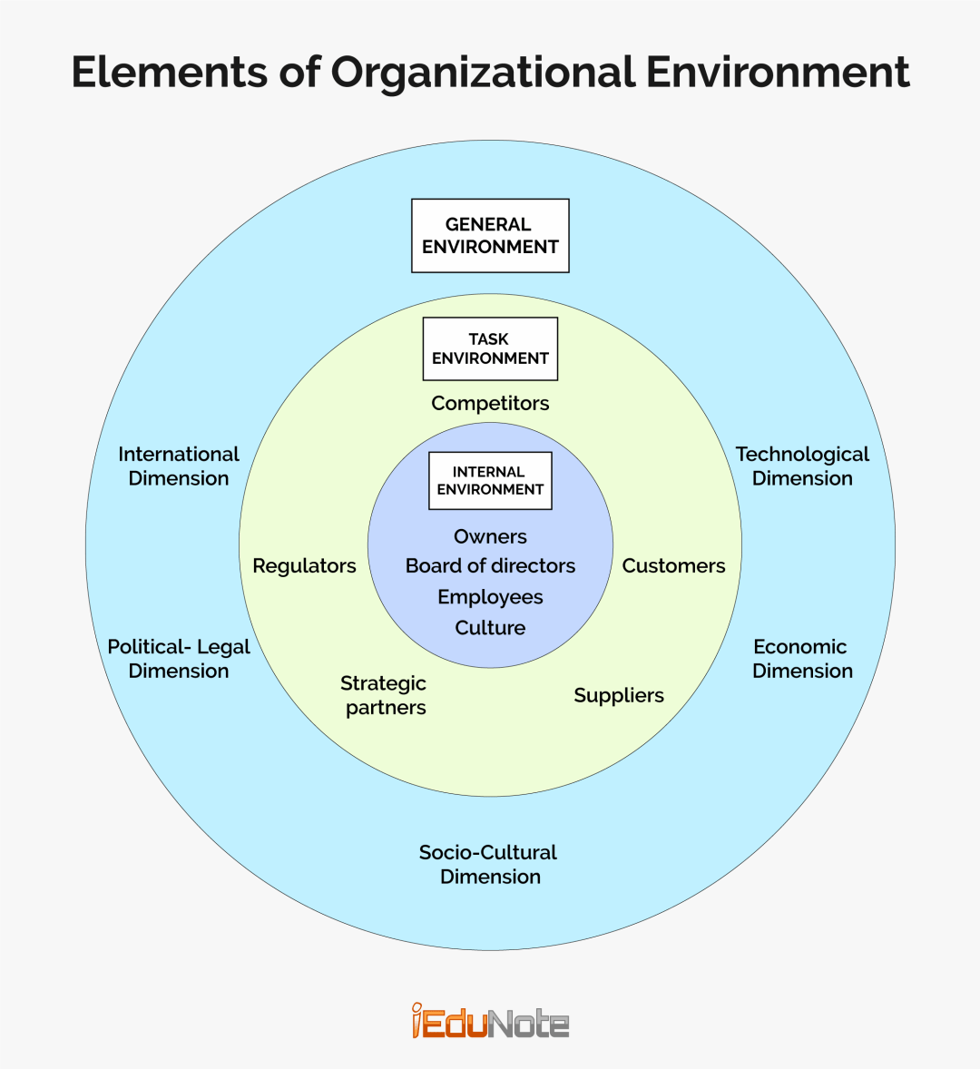

Slide 6
Classification / components of Business Environment:
INTERNAL ENVIRONMENT:
The internal environment refers to the conditions and resources within the organization. It is also called a firm or resource environment.
The internal environment is controllable by the manager in the long run. It determines the relative strengths and weaknesses of the firm. Strengths are the positive internal characteristics of the firm which are helpful for achieving desired goals.
And, weaknesses are the negative internal characteristics that might restrict the organization’s performance.
The primary responsibility of managers is to comprehend how to best utilize the important elements of the internal environment. A healthy internal environment aids in gaining a competitive advantage that directs a company in the direction of goal accomplishment.

Slide 7
Internal strength and weakness together with potential opportunities and threats and a clear mission statement provide a base for a sound objective and strategy formulation. The internal environment analysis seeks to give the answers to the following questions.
How well the current strategy is working?
What is our current situation?
What are our strengths and weaknesses?
How many resources are available?

Slide 8
Elements of Internal Environment:
1.Organizational goals and policies: profit growth, market growth, social responsibility, etc. are the goals of firm.
2. Organizational resource:
-Tangible resources: Financial, Organizational, Physical resources
- Intangible resources: Human resources( Knowledge, skill, ability, leadership) ,
Innovative resource ( Tactics, Innovation capacity), Reputation resources( Brand loyalty, customer relationship, quality)
3. Organizational structure: ( Job allocation, responsibility, accountability)
4. Organizational culture:( norms and value, behavior, belief)

Slide 9
External Environment:
An external environment is composed of all the outside factors or influences that impact the operation of business. The business must act or react to keep up its flow of operations. The external environment can be broken down into two types:
the micro environment and the macro environment.
Types of External Environments
The macro environment/General Environment consists of general factors that a business typically has no control over. The success of the company depends on its ability to adapt.
The operating/ Task environment

Slide 10
Components of Macro environment:
PESTLG analysis is a scan of the external macro-environment in which an organization exists. It is a useful tool for understanding the political, economic, socio-cultural, technological, and Global environment that an organization operates in.
It can be used for evaluating market growth or decline, and as such the position, potential and direction for a business;
Political environment
Economic Environment
Socio-cultural Environment
Technological Environment
Legal Environment
Global Environment

Slide 11
Political Factors: These include government regulations such as employment laws, environmental regulations and tax policy. Other political factors are trade restrictions and political stability. These actions may be local, regional, national and international level. Manager pay close attention to the political factors to measure how government actions will affect their company.
Economic environment -
It consists of the macro economy where all the trading, production, and distribution of wealth occurs. The economic environment has a direct impact on the working of the business. It also involves the international trading of goods and services.
These affect the cost of capital and purchasing power of an organization. Economic factors include economic growth, interest rates, inflation and currency exchange rates.

Slide 12
3. Socio-cultural environment - It consists of the socio-cultural beliefs of people which impact the life of the business in the society. Working with the customers' beliefs, values, and norms can be opportunistic for business.
This impact on the consumer’s need and the potential market size for an organization’s goods and services.
Attitudes, Beliefs, Religion, Language, Education, Family structure etc. affects the socio-cultural environment. 4. Technological environment - Technological environment consists of the practical application of advanced technology to produce goods and services. Advanced technology helps businesses to produce with less cost and earn higher revenues. This is the most dynamic environment because technology is updated frequently in a day. : These influence barriers to entry, make or buy decisions and investment in innovation, such as automation, investment incentives and the rate of technological change.

Slide 13
5. Legal environment - The legal and political environment is the regulatory environment that regulates businesses. It protects the interest of the consumers and prevents them from being exploited by businessmen under legal laws and regulations.
6.Global environment - The global environment consists of the opportunities, and threats businesses face in the domestic and international markets. It involves the interaction of domestic enterprises with international enterprises.

Slide 14
Operating/ Task Environment: It is related with competitive position of business. It includes,
Customer
Suppliers
Competitors
Financial institution
Distributors
Media
Government
Pressure group

Slide 15
Environmental Analysis:
An environmental analysis can be defined as the process by which the factors of the internal and external environment are monitored to find out the likely impact on the company’s performance.
The factors usually have both positive and negative impacts on the firm’s performance.
A successful environmental analysis includes both internal and external environment analysis. In which doing internal environment analysis is to find out a firm’s relative strengths & weaknesses. And conducting external environment analysis is to find out potential opportunities & threats to the firm.

Slide 16
Process of Environmental Analysis:
1.Scanning: The first step in the environment analysis is scanning the environment. Environmental scanning is about gathering information from the environment to assess its nature.
Environmental scanning helps to identify early signals of potential changes in the environment. Many firms also use special software and the internet for such scanning.
2. Monitoring:
Monitoring is auditing the environment. It involves the observation of environmental changes to see the trend.
It detects meaning in different environmental events and trends. It helps to identify the effects of the environment in terms of threat and opportunity.

Slide 17
3. Forecasting
The third step, forecasting is about assessing what is likely to happen in the future. Scanning and monitoring are concerned with events and trends in the general environment at a point in time.
And, forecasting involves developing involves feasible projections of what might happen and how quickly. It is done on the basis of trends and changes.
4.Assessing
Assessing determines the timing and significance of the effects of environmental changes and trends that have been identified. It specifies the implications of that understanding.
Assessing connects the data and information with competitive relevance. Equally important is interpreting the data and information to determine the trend as an opportunity or threat for the organization.

Slide 18
Techniques or Tools of Environmental Analysis
Effective environmental analysis is fundamental for making a marketing decision, future business planning, product abandoning or new product launching, and strategic management. The major tools for environment analysis are,
PESTLEG Analysis
Scenario Planning
Analysis of Industry Environment/ Porters Five Forces Model

Slide 19
PESTLEG Analysis
PESTLEG analysis monitors the effects of factors on the general environment. It helps managers to understand the overall condition of the market consisting of the present and likely future. PESTLEG stands for,
Political Environment. Political environment refers to the government actions that affect the operations of a business. Managers need to give close attention to political factors to measure how government actions will affect the company.
Economic Environment. It refers to the nature and direction of the economy in which a company competes or operates. Factors such as GDP, inflation rate, employment rate, exchange rate, etc. are important to consider.
Socio-cultural Environment. People’s norms, beliefs, traditions, culture, education, languages, taste, preferences, etc. are important factors of this environment that a manager needs to pay close attention to.

Slide 20
Technological Environment. This environment talks about how advances in technology, level of technology, technology transfer, research & development budget, etc. affect the company’s performance.
Legal Environment. The legal environment of a business is composed of the constitution, business-related laws, courts, and law administration.
Ecological Environment. This refers to potential and actual changes in the physical or ecological environment. It also refers to the business practices that are intended to positively respond to these changes.
Global Environment. The global environment of a business includes relevant global markets, international political events, and critical cultural characteristics of global markets.

Slide 21
Scenario Planning:
Scenario planning is a technique of depicting future possibilities and preparing accordingly. It is also called contingency planning.
Scenarios are carefully crafted stories about the future representing a wide variety of ideas and integrating them in a way that is communicable and useful. They are stories about how the future might unfold and affect business issues.

Slide 22
Porter's Five Forces Model
It is a framework developed by Michael Porter for analyzing the competitive environment in an industry.
The model is widely used in strategic management to help organizations understand the key factors that determine the level of competition in their industry. The five forces that make up the model are:
1.Threat of New Entrants: This force assesses the likelihood of new competitors entering the market. Factors that can increase the threat of new entrants include low barriers to entry, low capital requirements, and weak incumbent companies.

Slide 23
2.Bargaining Power of Suppliers: This force evaluates the power of suppliers to set prices or control the quality of goods and services.
Factors that can increase the bargaining power of suppliers include a small number of suppliers, high switching costs, and unique or differentiated inputs.
3.Bargaining Power of Buyers: This force analyzes the power of buyers to negotiate prices and terms of purchase. Factors that can increase the bargaining power of buyers include a large number of buyers, low switching costs, and a high degree of price sensitivity.

Slide 24
4.Threat of Substitutes: This force considers the possibility of customers switching to alternative products or services.
Factors that can increase the threat of substitutes include low switching costs, the availability of substitutes, and the similarity of substitutes to the original product or service.
5.Rivalry Among Existing Competitors: This force examines the intensity of competition among existing players in the market. Factors that can increase rivalry include a large number of competitors, low product differentiation, and slow industry growth

Slide 25
Importance of Environmental Analysis:
Helps in identifying threats and opportunities.
Helps in determining strengths and weaknesses.
Helps to identify competitive advantage.
Helps to formulate new plans and strategies.
Fit for big companies.
Helps in plans and strategies implementation.
Helps to adjust to changing business environment.

Slide 26
ETOP ( ENVIRONMENTAL THREAT AND OPPORTUNITY PORFILE)
ETOP analysis is the process by which organization monitor their relevant environment to identify opportunities and threats affecting their business for the purpose of taking strategic decisions.

Slide 27
Why ETOP is needed ?
Helps organization to identify opportunities and threats
To consolidated and strengthen organizations position
Provides the strategists of which sectors have a favorable impact on the organization
Helps organization know where it stands with respect to its environment
Helps in formulating appropriate strategy
Helps in formulating SWOT analysis

Slide 28
How to prepare an ETOP?
Dividing the environment into different sectors such as economical, market, social, international, legal technological, political, ecological etc.
Analyzing the impact of each sector on the organization
Sub-dividing each environmental sector into sub factors
Impact of each sub-sector on organization in form of a statement.

Slide 29
Strategic Group:

Slide 30
HYPER-COMPETITION:
Hyper-competition can be defined as organizations' use of tactics to disrupt the competitive advantage held by industry leaders. Hyper-competition typically occurs at a rapid pace.
For example, let's say that you own a fast-food restaurant and your items are priced slightly higher than a rival fast-food chain. If you decide to adjust your prices to be closer to or lower than your rival, that is hyper-competition.
For organizations looking to succeed in a hypercompetitive market, there are four factors that need to be mastered:
Technology and innovations
Customer changes
Decline of boundaries
Financial independence

Slide 31
METHODS / TECHNIQUES OF INTERNAL ENVIRONMENT ANALYSIS
Internal analysis or internal environment analysis is an attempt to the identification of organizational capabilities which can be done through various methods/tools/ or techniques.
Internal analysis is an important tool to understand the internal activities of an organization. It gives information about how its strategies are working, its resource base, relative strengths & weaknesses, and helps to formulate effective strategies.

Slide 32
Value chain Analysis:
Value chain analysis is a process whereby by a firm determines the cost associated with organizational
activities from purchasing raw materials to manufacturing products to marketing those products.
A business may have a different chain of activities that converts into a usable product that creates customer value. It examines how an organization creates customer value through its different activities.
Activities in the value chain include primary and secondary activities.

Slide 33
Primary Activities:
Inbound Logistics – They include the activities such as materials handling, warehousing, and inventory control.
Operations – They include activities to convert the input provided by inbound logistics into final product form.
Outbound Logistics – They include activities relating to the distribution of products to final consumers.
Marketing and Sales – They are the marketing efforts to persuade customers to purchase the products.
Services – Activities designed to enhance or maintain a product’s value.

Slide 34
Secondary Activities:
Procurement – It includes the purchase of inputs needed to produce products.
Technological Development – Includes the activities related to improving a firm’s products and manufacturing products.
HRM – Includes activities of recruiting, hiring, training, developing, and compensating employees.
Firm Infrastructure – Includes activities such as general management, planning, finance, accounting, legal support, and government relations.

Slide 35
2.Cost Efficiency Analysis
Cost efficiency analysis is a decision making tool which can be used to discuss the economic efficiency of a program or a project. The tool compares policies, programs or projects in order to identify the most appropriate one to achieve a result at least cost.
Cost efficiency in an organization can be achieved in a variety of ways:
Economies of scale: It is cost reduction techniques by following ways;
Bulk purchasing of inputs
High volume of output
Optimum capacity utilization
Worldwide distribution network
Better production or operation management.

Slide 36
Supply costs: It consist of cost of inputs and inbound logistic. Lowering the supply cost is essential to get cost efficient result which can be achieved in following ways:
Vertical integration
Just-in-time method
Supply chain management
Management information system
Efficient production methods, such as mass production as in the motor industry.
Experience curves, which illustrate the rule that over a period of time the costs of production will decrease in relation to the number of units produced, as experience is gained in processes, material purchasing, etc.

Slide 37
3. Effectiveness Analysis
Effectiveness analysis is widely known as product feature analysis. Physical features of the product that creating the value to the customers is measured in effectiveness analysis. In general, aesthetic features of the product-looks, size, color, structure etc create value to the customers.
( don't judge the book looking its cover)
If a product meets customers requirement at expected cost by giving expected quality, it is said the product effectiveness. So, product analysis deals with following two dimensions;

Slide 38
Customer requirement
Value added by company
Customer requirement is satisfied, if the company offers them the product with aesthetic features, and their service expectations and price sensitivity.
Value addition to customers can be enhanced through extra quality and quantity of product, after sales service and communication the customers about the product features.

Slide 39
4.Comparative Analysis
Comparative analysis is a tool to measure the company's performance by comparing company's position with industry's norms and standards. This is used to see how the value system of an organization has changed over a period of time.
It is carried out mainly by considering the history of the company itself or by comparing its performance with the norms of the industry within which it operates.
Comparative analysis is done to assess financial performance and sales effectiveness of the company. So, it is possible to identify by looking at financial ratios such as sales/capital and sales/employees and comparing current values with those of recent years. Comparing the company's position in terms of these factors with the norms for the industry helps to identify its relative position with respect to its competitors.

Slide 40
Three ways of approaching the analysis of a company's current and past performance are:
Historical analysis of performance;
Comparison with the relative performance of organizations in the same industry, i.e. with industry norms; or
Benchmarking, i.e. a comparison against the best performers.

Slide 41
SWOT Analysis:
A SWOT analysis is a simple but widely used tool that helps in understanding the strengths, weaknesses,
opportunities and threats involved in a project or business activity.
It starts by defining the objective of the project or business activity and identifies the internal and external factors that are important to achieving that objective. Strengths and weaknesses are usually internal to the organization, while opportunities and threats are usually external.

Slide 42
Strength:
-Excellent sales staff with strong knowledge of existing products
- Good relationship with customers
- Good internal communications
- High traffic location
- Successful marketing strategies
Reputation for innovation
Weakness:
-Currently struggling to meet deadlines - too much work?
- High rental costs
- Market research data may be out of date
- Cash flow problems
- Holding too much stock
- Poor record keeping

Slide 43
Opportunities:
-Similar products on the market are not as reliable or are more expensive
- Loyal customers
- Product could be on the market for Christmas
Customer demand - have asked sales staff for similar product
Threats:
-Competitors have a similar product
- Competitors have launched a new advertising campaign
- Competitor opening shop nearby
- Downturn in economy may mean people are spending less

Slide 44
Resource Based View Strategy ( RBV):
Resource-based view states that organizations’ internal resources are more critical to achieving competitive advantage. It states the following important resources,
1. Available Resources: Resources that are currently available in the organization.
Physical Resources – Include all plant and equipment, location technology, raw materials, and machines.
Human resources – include all employees, training, experience, knowledge, skills, and abilities.
Financial resources- sources of finance, capital structure, relationship with other financial institution.
Intellectual resources- patent right, brand loyalty, customer database, business system

Slide 45
2. Threshold Resources: Those which are needed to meet customers' minimum requirements and therefore to continue to exist. In the competitive business world; technology, IT infrastructure, AI, large scale operation are threshold resources..
3. Unique Resources: The resource that are critical for gaining competitive advantage are called unique resources. They are extraordinary, valuable, non-substitutable ,costly to imitate and rare.

Slide 46
Competency:
A strategic management competency is the competency of a business organization to achieve and sustain a competitive advantage.
A competency is something that an organization is good at doing. It is an activity that an organization has learned to perform well.
Core competency:
Core competencies are the resources and capabilities that comprise the strategic advantages of a business.

Slide 47
Distinctive competence:
Distinctive competence refers to a superior characteristic, strength, or quality that distinguishes a company from its competitors.
When the core competency is superior to those of competitors it is called distinctive competence.

Slide 48
Sustainable Competitive Advantage:
Competitive advantage exists when a particular company consistently outperforms other companies in the same industry. A company is considered to be outperforming others if profits are higher than the competition's profits.
The competitive advantage is thought to be stronger when it lasts for a longer period of time. Those companies who are able to maintain a competitive advantage for many years are thought to have a sustainable competitive advantage.

Slide 49
Knowledge:
-facts, information, and skills acquired through experience or education; the theoretical or practical understanding of a subject.
Knowledge Management:
Knowledge management (KM) is the process of identifying, organizing, storing and disseminating information within an organization. When knowledge is not easily accessible within an organization, it can be incredibly costly to a business as valuable time is spent seeking out relevant information versus completing outcome-focused tasks.

Slide 50
A knowledge management system (KMS) harnesses the collective knowledge of the organization, leading to better operational efficiencies. These systems are supported by the use of a knowledge base.
Companies with a knowledge management strategy achieve business outcomes more quickly as increased organizational learning and collaboration among team members facilitates faster decision-making across the business. It also streamlines more organizational processes, such as training and on-boarding, leading to reports of higher employee satisfaction and retention.

